Slide 1
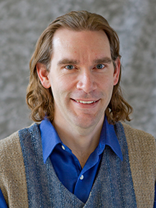
Internet of Things (IoT) Demo
Managing a Resource Trading Network
Martin Madsen
Ph.D. in Experimental Physics
16 years’ experience working with sensors, data collection, data analysis, and predictive model building

Slide 2
Scenario: Allocating Resources
Auto
Electric charging stations
Street sweepers
Buses
Fryers
Aircrafts
Surveillance
Vaccine dispensers
Smart meters
Power plant
Cows
Oil equipment
Elevators
Factory floor
Racing
Buildings
Mining equipment
Vending machines
Power tools
Postboxes
Oil distribution
Engines
Medical devices
Dogs
Trucks
Smart grids

Slide 3
Scenario: Allocating Resources
Auto
Electric charging stations
Street sweepers
Buses
Fryers
Aircrafts
Surveillance
Vaccine dispensers
Smart meters
Power plant
Cows
Oil equipment
Elevators
Factory floor
Racing
Buildings
Mining equipment
Vending machines
Power tools
Postboxes
Oil distribution
Engines
Medical devices
Dogs
Trucks
Smart grids

Slide 4
Scenario: Allocating Resources
Auto
Electric charging stations
Street sweepers
Buses
Fryers
Aircrafts
Surveillance
Vaccine dispensers
Smart meters
Power plant
Cows
Swap Items
Oil equipment
Elevators
Factory floor
Racing
Buildings
Mining equipment
Vending machines
Power tools
Postboxes
Oil distribution
Engines
Medical devices
Dogs
Trucks
Smart grids

Slide 5
Scenario: Allocating Resources
Auto
Electric charging stations
Street sweepers
Buses
Fryers
Aircrafts
Surveillance
Smart meters
Dogs
Power plant
Cows
Oil equipment
Elevators
Factory floor
Racing
Buildings
Mining equipment
Improved Group
Vending machines
Power tools
Postboxes
Oil distribution
Engines
Medical devices
Vaccine dispensers
Trucks
Smart grids

Slide 6
Fixed Resources
Auto
Electric charging stations
Street sweepers
Buses
Fryers
Aircrafts
Surveillance
Smart meters
Dogs
Power plant
Cows
Oil equipment
Elevators
Factory floor
Racing
Buildings
Mining equipment
Vending machines
Power tools
Postboxes
Oil distribution
Engines
Medical devices
Vaccine dispensers
Trucks
Smart grids

Slide 7
Auto
Electric charging stations
Street sweepers
Buses
Fryers
Aircrafts
Surveillance
Resource Mobility
Cost to Transport
Distance to Move
Smart meters
Dogs
Power plant
Cows
Payoff for Moving
Oil equipment
Elevators
Factory floor
Racing
Buildings
Mining equipment
Vending machines
Power tools
Postboxes
Oil distribution
Engines
Medical devices
Vaccine dispensers
Trucks
Smart grids

Slide 8
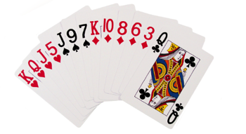
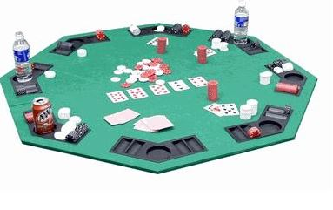
Demonstration Resources
Swap Cards

Slide 9
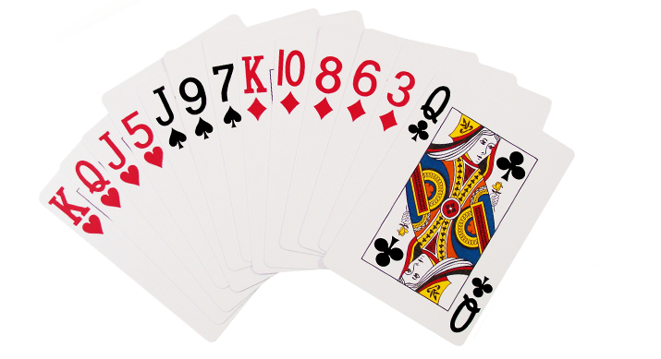
Use XGBoost to Score Hands
High Card
Pair
Two Pair
Three of a Kind
Straight
Flush
Full House
Four of a Kind
Straight Flush
Royal Flush
0
1
2
3
4
5
6
7
8
9

Slide 10
Model Test Performance
High Card
Pair
Two Pair
Three of a Kind
Straight
Flush
Full House
Four of a Kind
Straight Flush
Royal Flush
0
1
2
3
4
5
6
7
8
9

Slide 11
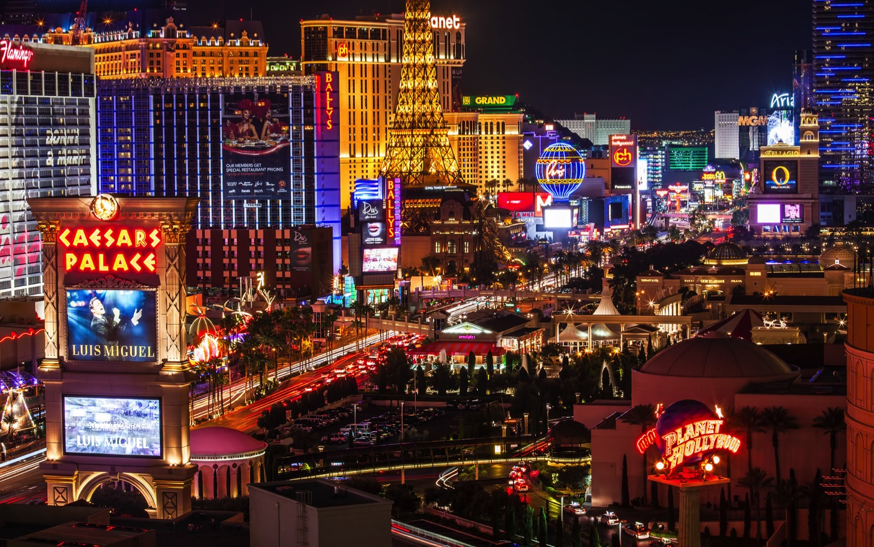
Geography
12 “casinos” in Las Vegas
1 “casino” in Atlantic City
Each “casino” has
3 poker rooms
2 tables in each room
2 hands at each table
https://jamesb.com/wp-content/uploads/2013/11/vegas-business-X3.jpg

Slide 12
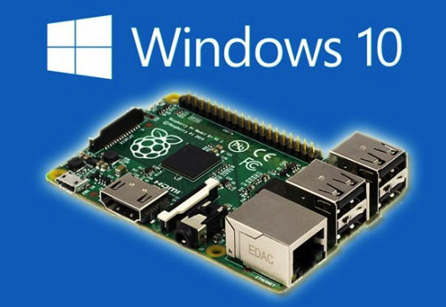

Card Simulation
Transportation Cost
Cost of moving the card (per kilometer)
Occupation Level
Very high for “table” cards that cannot be traded

Slide 13
Card Simulation
Devices can change cards (Card properties)
Devices can move locations
(Hand properties)

Slide 14
IoT Architecture
Devices
Azure IoT
Back end systems and processes
Node.js
simulator
IoT Hub
Web Jobs

Slide 15
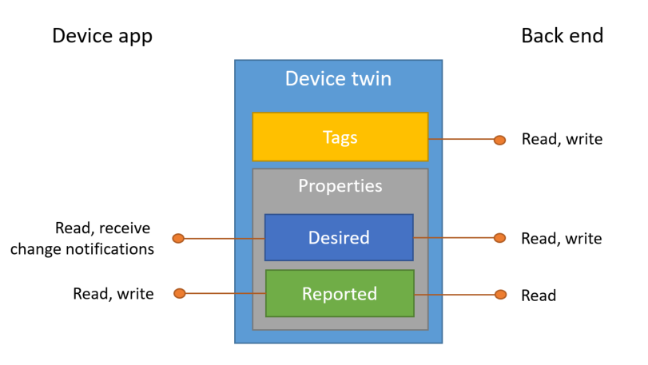
Device Twins

Slide 16
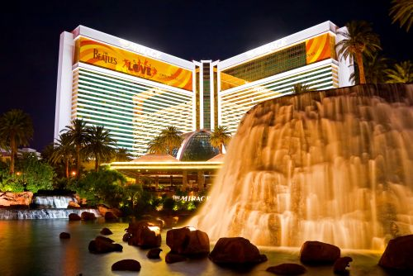
Device Twins
Device
Server Twin
Mirage

Slide 17
Device Twins
Device
Server Twin
Reported
Mirage

Slide 18
Device Twins
Device
Server Twin
Reported
Mirage
Mirage

Slide 19
Device Twins
Device
Server Twin
Mirage
Mirage

Slide 20
Device Twins
Device
Server Twin
Card Change
Mirage
Mirage

Slide 21
Device Twins
Device
Server Twin
Card Change
Desired
Mirage
Mirage

Slide 22
Device Twins
Device
Server Twin
Card Change
Changing…
Desired
Mirage
Mirage

Slide 23
Device Twins
Device
Server Twin
Mirage
Mirage

Slide 24

IoT Architecture
Devices
Deal Cards
Azure IoT
Back end systems and processes
Execute Trades
Node.js
simulator
IoT Hub
Web Jobs

Slide 25
IoT Architecture
Devices
Deal Cards
Azure IoT
Back end systems and processes
Execute Trades
Node.js
simulator
IoT Hub
Web Jobs

Slide 26
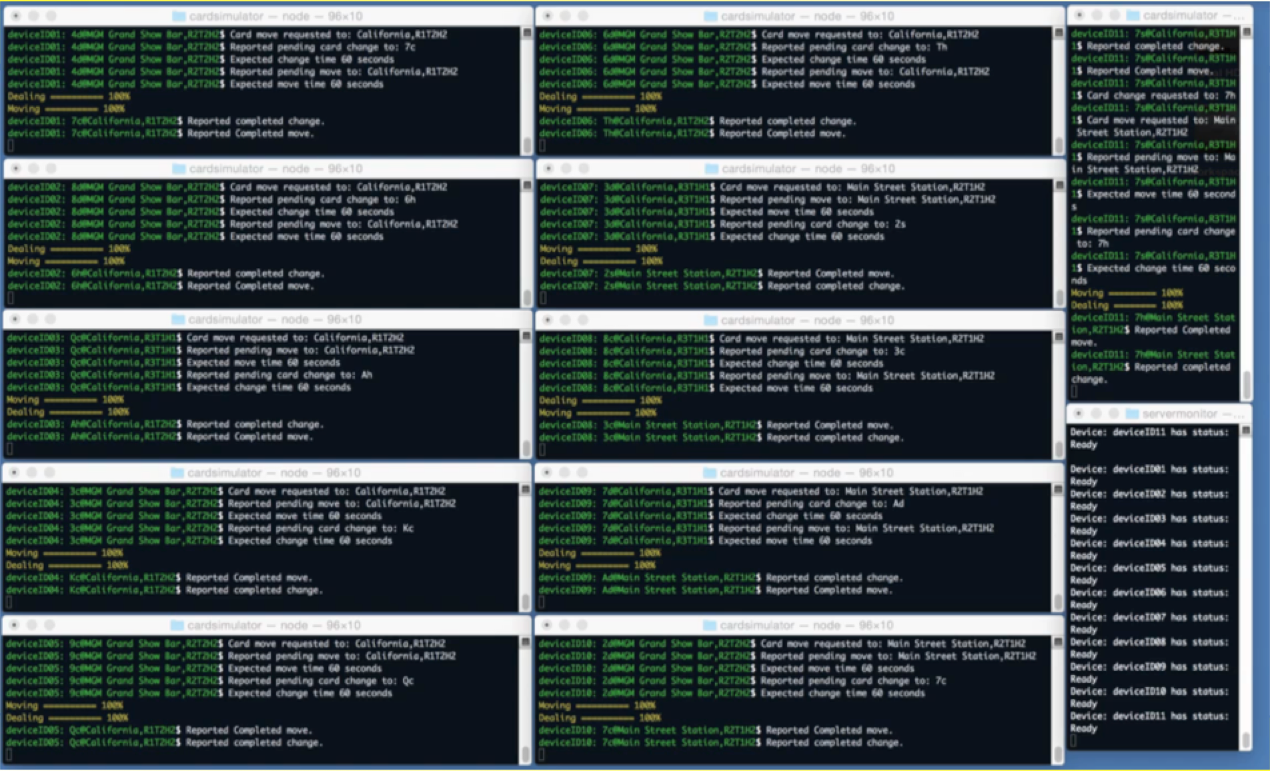
Card Dealing Demo
Card Simulation

Slide 27
Card Dealing Demo
Device 01
Device 06
Card Simulation
Device 11
Device 02
Device 07
Device 03
Device 08
Device 04
Device 09
Server
Monitor
Device 05
Device 10

Slide 28
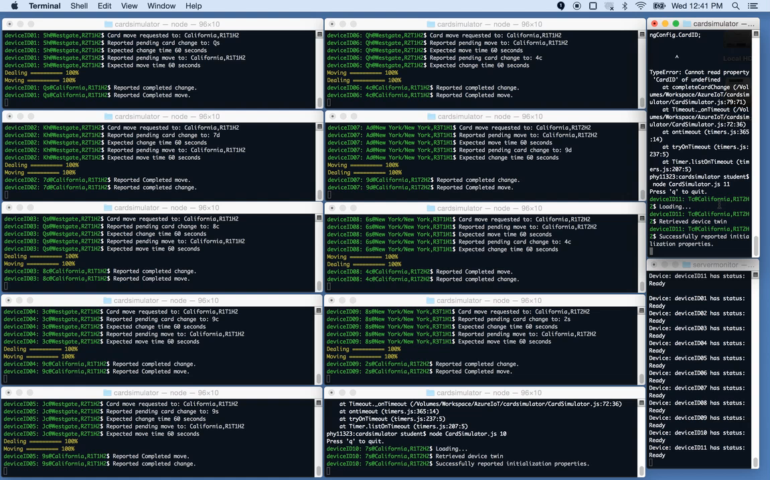

Slide 29
IoT Architecture
Devices
Deal Cards
Azure IoT
Back end systems and processes
Execute Trades
Node.js
simulator
IoT Hub
Web Jobs
Azure ML

Slide 30
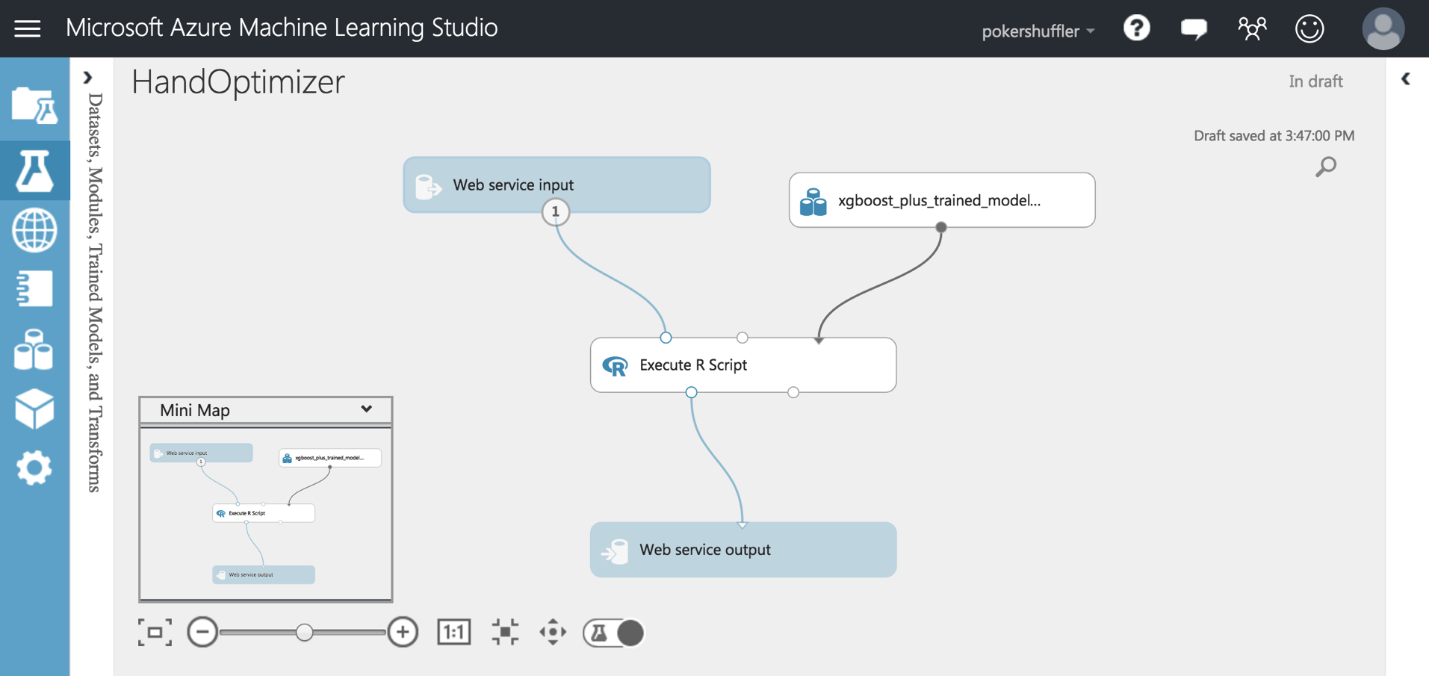

Slide 31
Hand Optimizer Algorithm
Swap Cards

Slide 32


Slide 33
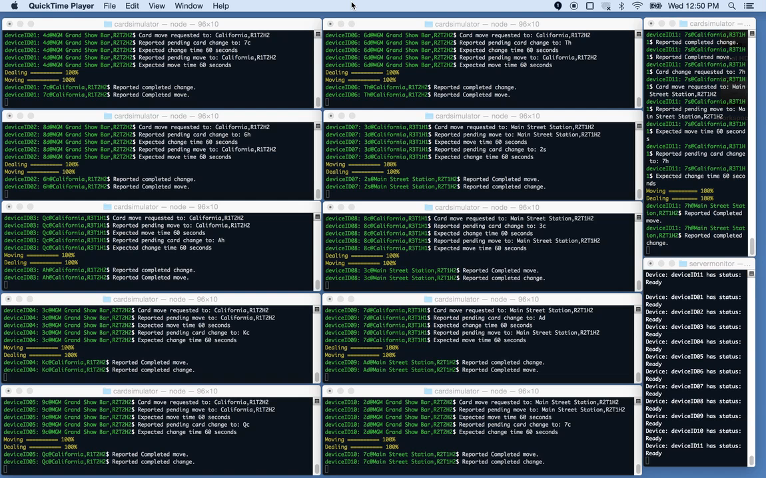

Slide 34
IoT Architecture
Devices
Deal Cards
Azure IoT
Back end systems and processes
Execute Trades
Node.js
simulator
IoT Hub
Web Jobs
Azure ML

Slide 35
Summary
Auto
Electric charging stations
Street sweepers
Buses
Fryers
Aircrafts
Surveillance
Vaccine dispensers
Smart meters
Power plant
Cows
Oil equipment
Elevators
Factory floor
Racing
Buildings
Mining equipment
Vending machines
Power tools
Postboxes
Oil distribution
Engines
Medical devices
Dogs
Trucks
Smart grids

Slide 36

Summary

Slide 37
Summary

Slide 38
Thank You!
Questions, comments, or further conversation:
Martin John Madsen
https://www.linkedin.com/in/martinjohnmadsen
Notes:
[Josh’s Slide]

